Slide 1
Data Structures & Algorithms (CSC-214)
Lecture 19: Binary Trees

Slide 2
Search for a node

Slide 3
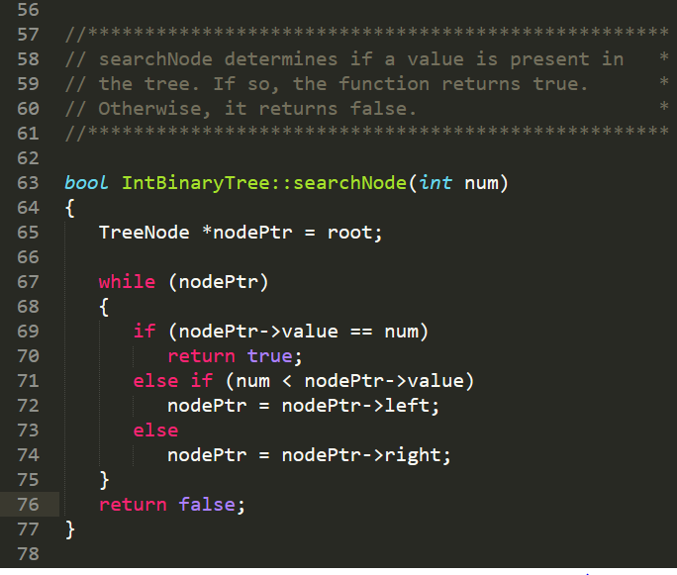

Slide 4
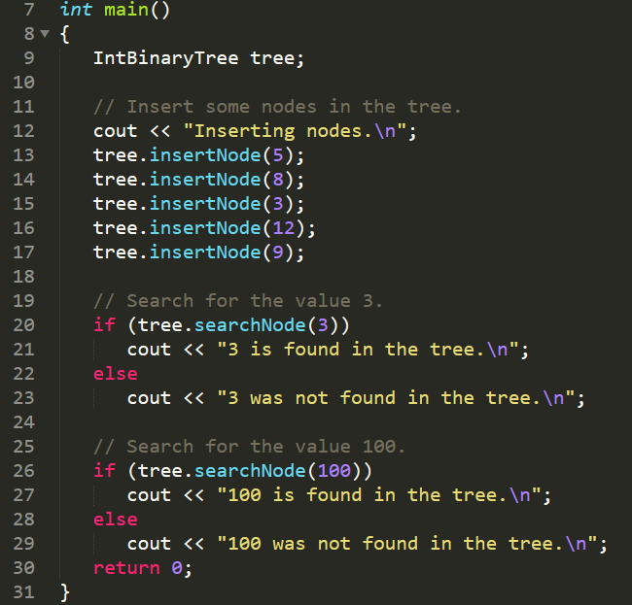

Slide 5
Delete a node

Slide 6
Deleting a leaf is simple

Slide 7
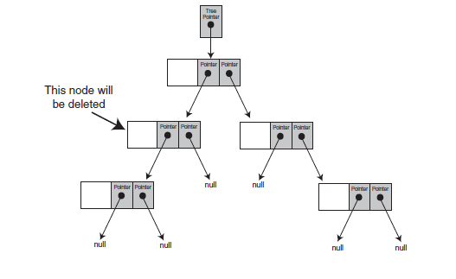
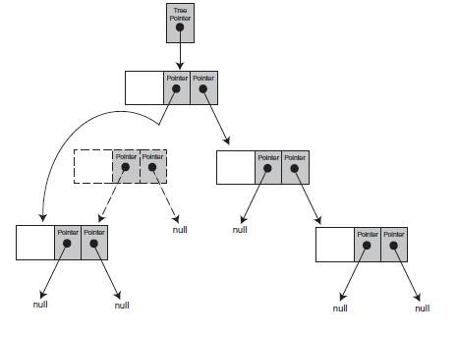
Deleting internal node
with one subtree.

Slide 8
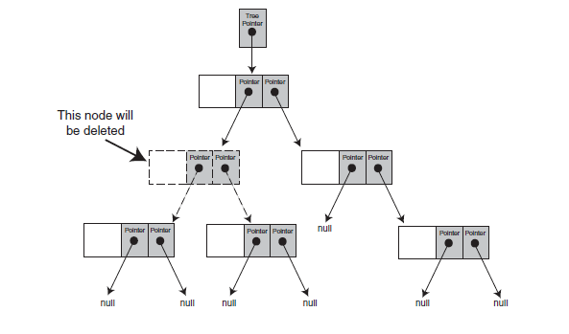
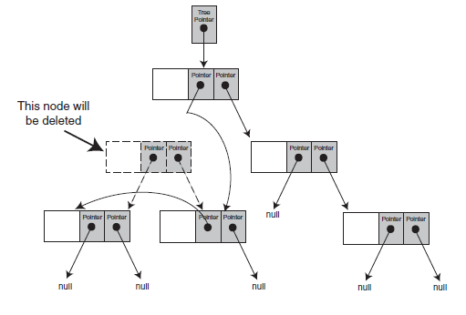
For the deletion you need to ensure that the properties of a bst are maintained, there are multiple ways in which this can be done. One is covered here.
Delete a node with 2 subtrees:
Attach the node’s right subtree
to the parent, then find a position
in the right subtree to attach the
left subtree.

Slide 9
Delete examples

Slide 10
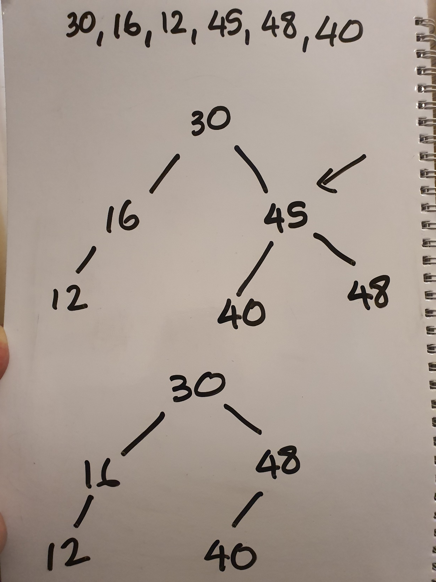

Slide 11
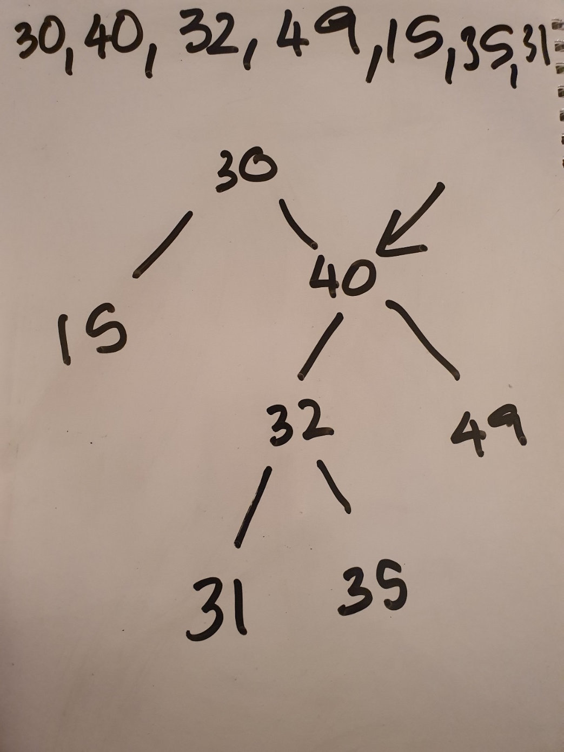
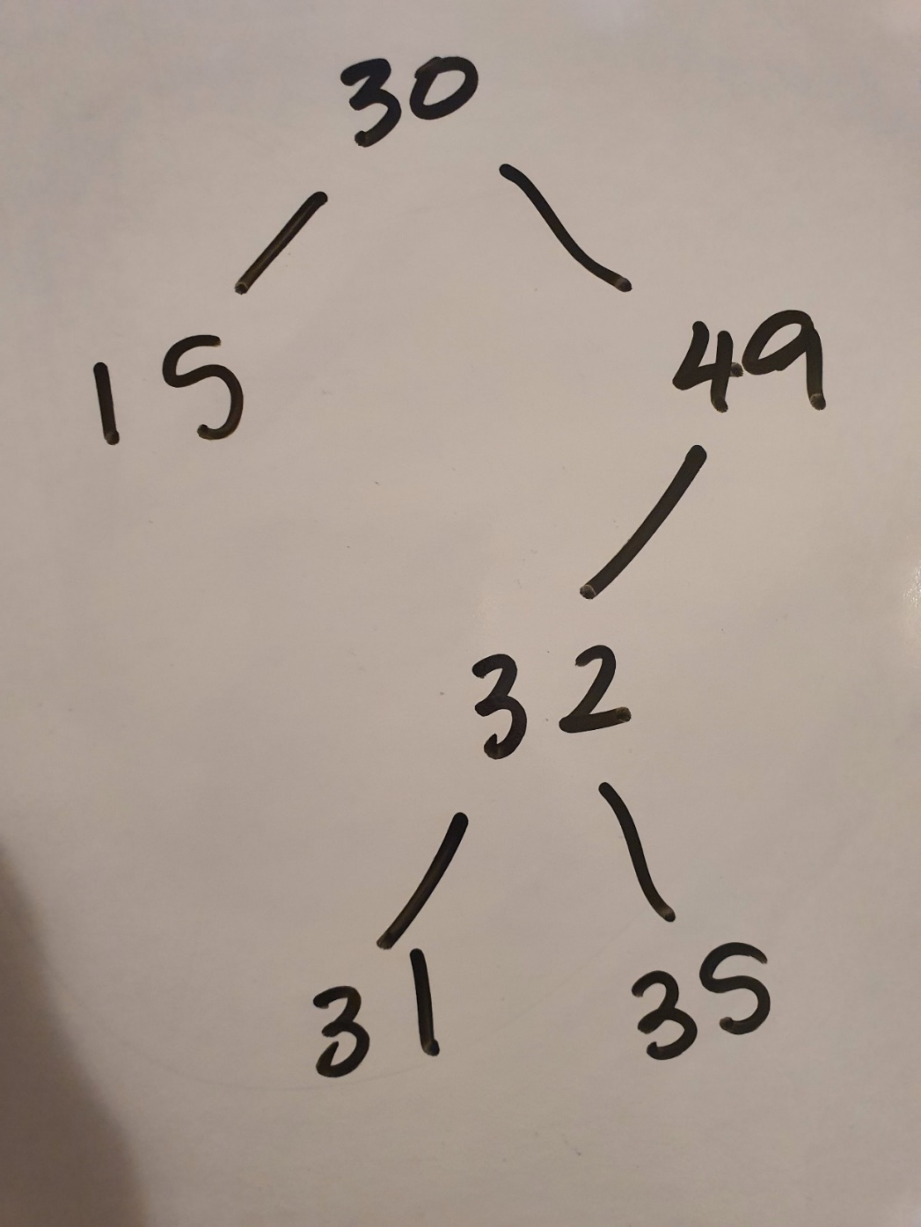

Slide 12
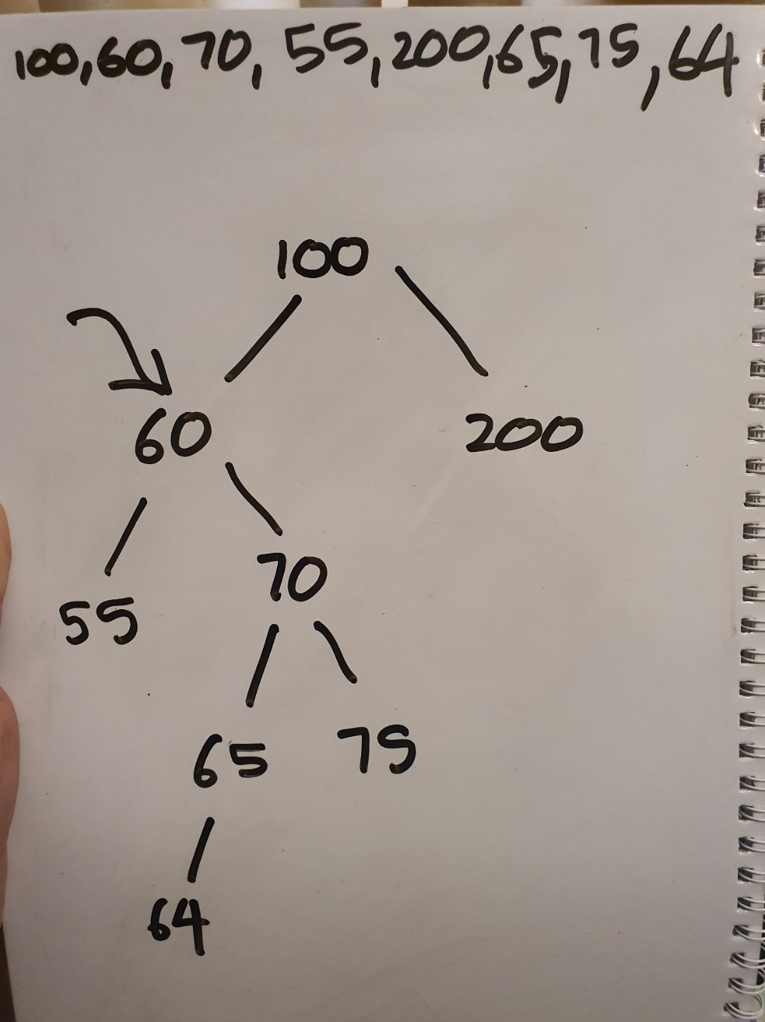
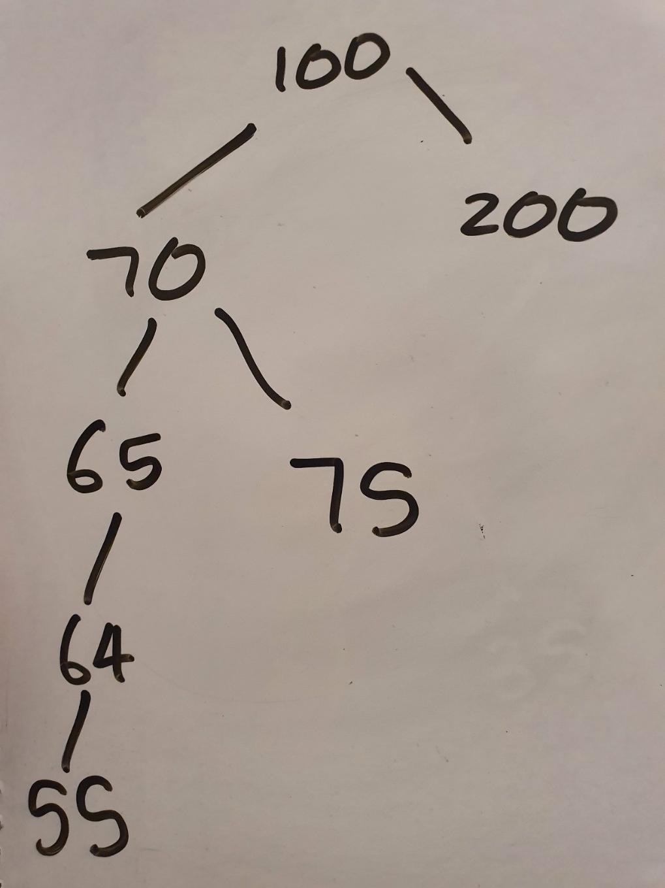

Slide 13
Delete code

Slide 14
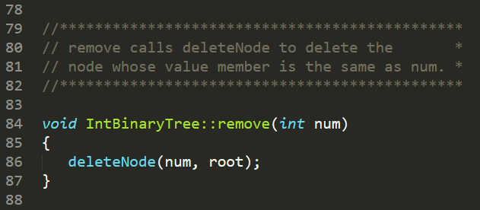

Slide 15
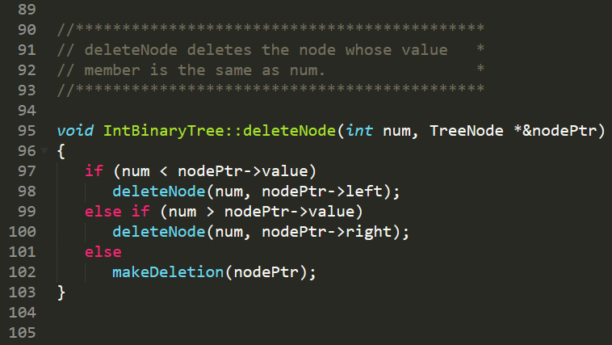

Slide 16
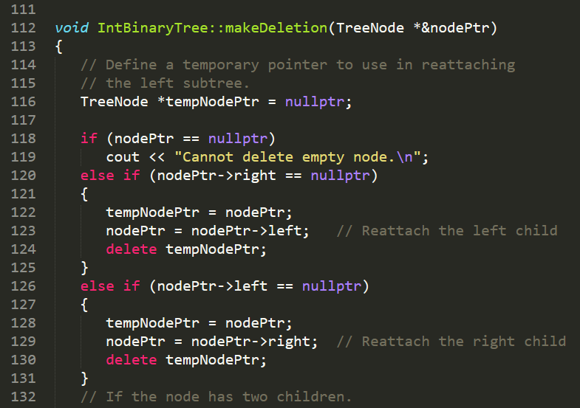

Slide 17
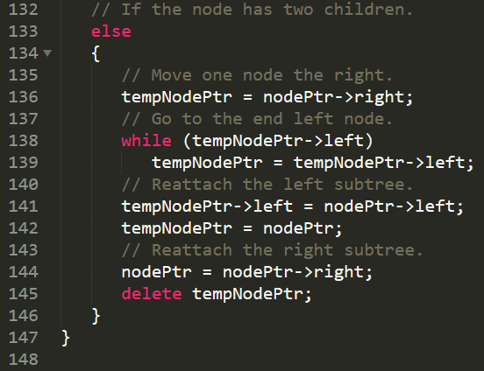

Slide 18


Slide 19
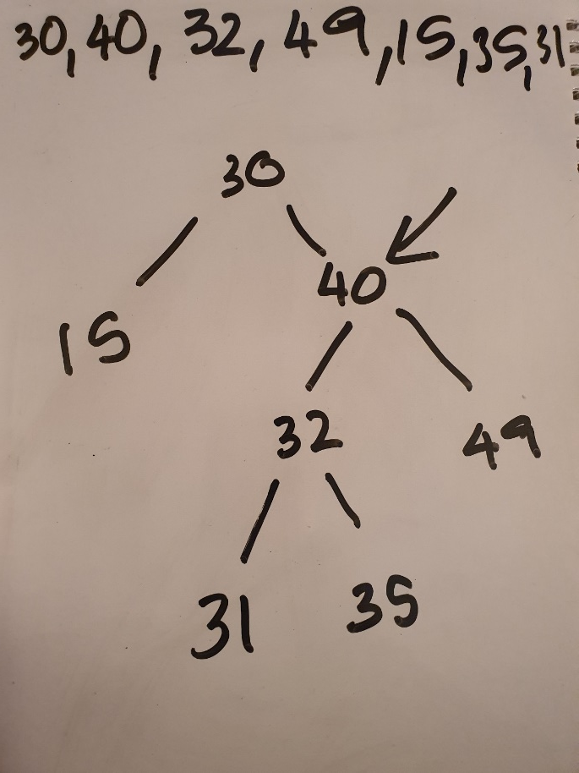
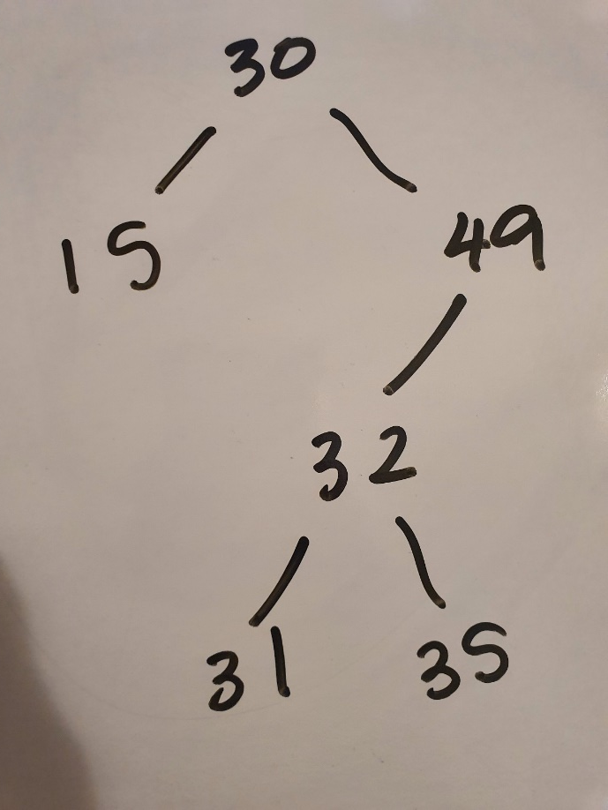

Slide 20

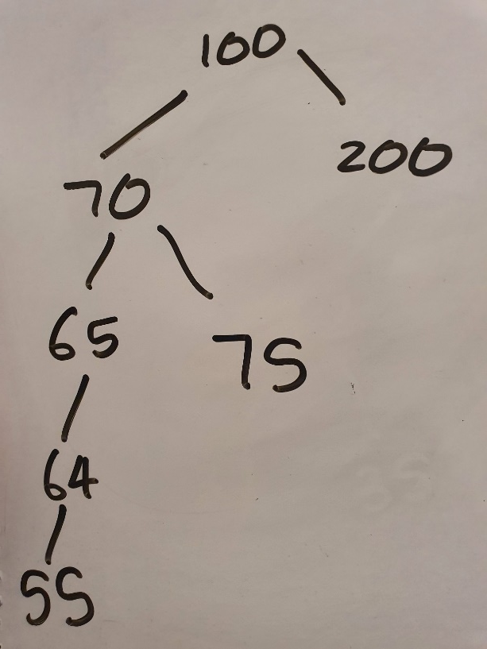

Slide 21
Lecture content adapted from Tony Gaddis textbook chapter 20.

